Slide 1
David Hanson
Case Manager Developer
September 11, 2013
Product Maintenance Training (PMT)
IBM Case Manager 5.2
ICM Model API

Slide 2
Introduction
Course Overview
  Present the Case Client Model API introduced with ICM 5.2
Target Audience:
  Anyone designing or supporting solutions with ICM 5.2
Suggested Prerequisites:
  General familiarity with ICM and client JavaScript development
Version Release Date: September, 2013
© Copyright International Business Machines Corporation 2013. All Rights Reserved.
US Government Users Restricted Rights - Use, duplication or disclosure restricted by GSA ADP Schedule Contract with IBM Corp.

Slide 3
Course Objectives
After this course you will be able to:
Understand where the Model API fits in the overall Case Client
Recognize when and how the model API should be called

Slide 4
Course Roadmap
  Explain what is the model API
  When to use the model API
  What functionality it provides
  Course Summary

Slide 5
What is the Model API?
The ICM Model API are JavaScript classes that are part of the larger ICM JavaScript Toolkit
They are non-UI components and generally represent ICM objects in the repository such as Solution, Case, Task, etc.
They communicate with mid-tier services through a navigator plug-in.
Like with the navigator model API and services, the public API is the JavaScript Model API. The plug-in services are not public API.
  We do not expect custom code to call the plug-in services directly through HTTP. The only supported use is a JavaScript client calling the model classes.
The model classes extend and reuse some navigator model classes.
The model classes provide functionality where it is not sufficient or possible to achieve through the navigator API alone.

Slide 6
5.2 Case Client Architecture
IBM Content Navigator web client
Case Manager Case Client
Page 1
Page n
Properties page widget
In-basket page widget
Toolbar
page widget
Case Information
page widget
Page widget
events
InBasketContainer
Custom Action
Add case action
Content grid
Add Doc dlg
Case Toolbar
page widget
events
ReAssign Dialog
Comment Action
Content Navigator Model
Case Manager Model
Desktop
Repository
Result Set
Request
…
Solution
Case
Task
Property Controller
…
Model API and Plug-in Services
Content Navigator Mid-Tier Services
Case Manager Mid-Tier Services

Slide 7
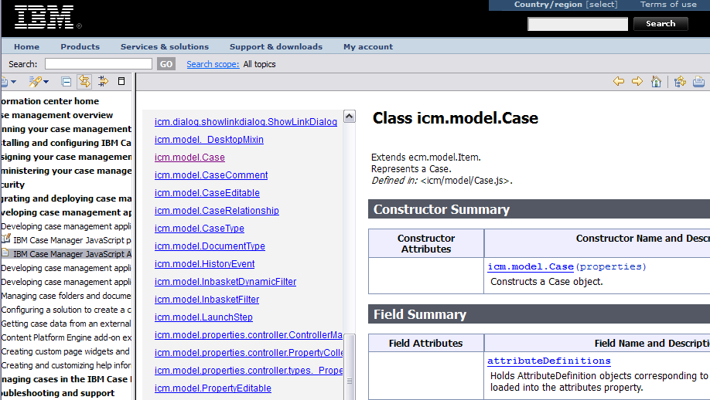
Part of the overall ICM JavaScript Toolkit
The ICM Model API are classes under the icm.model package

Slide 8
Alternative to REST APIs
Case Client 5.2 calls the ICM model classes for functionality that Case REST (runtime features only) provided in previous releases
  Communicating with the mid-tier through plug-in services
Benefits of integrating with navigator services through plug-ins
  Sharing connection to the server and the performance and simplified session management that comes with that
  Sharing of the Request model object and its links to the desktop for free message logging, status, relogin, and error dialogs
Likewise the core navigator model classes are used where PE REST and CMIS were used previously
The model classes offer similar functionality as REST but in the form of an object-oriented API
  Objects with state and encapsulate that state as you would expect

Slide 9
Course Roadmap
  Explain what is the model API
  When to use the model API
  What functionality it provides
  Course Summary

Slide 10
When is the model API used?
In developing a custom widget
  Model object passed as part of the payload of an event
May be called by a Script Adapter

Slide 11
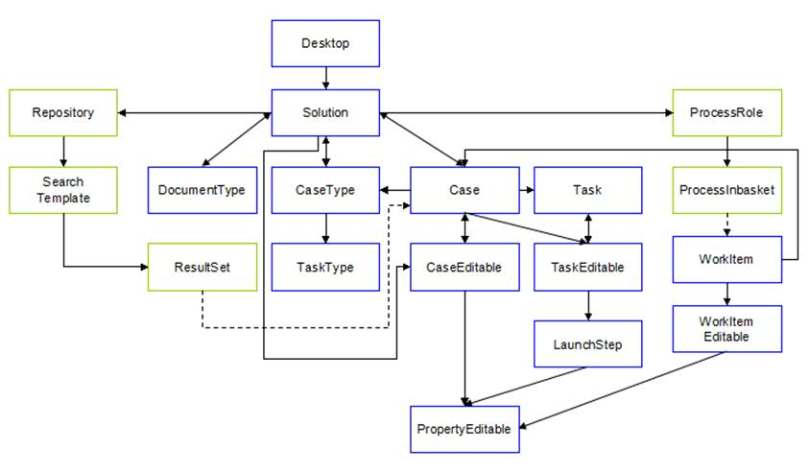
Model Object Navigation

Slide 12
Course Roadmap
  Explain what is the model API
  When to use the model API
  What functionality it provides
  Course Summary

Slide 13
Model API Functionality
Retrieve the deployed solutions
  Solutions deployed to any target object store registered with the navigator desktop
For a particular solution
  Retrieve the case type or documents types
  Retrieve information about the properties across all case types
  Retrieve the roles
  Retrieve the static pages to show for a particular role
For a particular case type
  Attributes include
    What rights the user has to cases of that case type
    Whether dynamic (custom) tasks are supported
    The default view definition to use when editing cases of this type
  Retrieve information about the properties of the case type
  Retrieve the discretionary task types that can be created
  Discover the particular page to use for a page type and role
  Search for dynamic tasks compatible with this case type (attached to cases of this type)

Slide 14
Model API Functionality (2)
For case objects
  Retrieve a particular case or obtain a Case model object given a navigator ContentItem (for example from a folder based search)
  Create a case
  Update the properties of a case
  Split a case
  Relate cases together
  Retrieve the cases that are related to a case (through splitting a case or generally relating cases together)
  Add and retrieve comments on cases
  Retrieve the case history
  Retrieve the tasks associated with a case
Classes for navigating the new case timeline history

Slide 15
Model API Functionality (3)
For task objects
  Start a manual task
  Enable and disable certain tasks
  Stop and restart the workflow associated with a task
  Create a discretionary task
Dynamic (custom) tasks
  Create a dynamic task
  Update the data that describes the dynamic task and indicate if the data is valid (allowing the task to be started)
  Start a dynamic task, causing dynamic workflow to be created and launched

Slide 16
Model API Functionality (4)
Work items
  ICM Model exposes a WorkItem object that encapsulates some ICM specific behavior
    Better integration with case properties in the API
  Retrieve a particular work item or obtain an ICM WorkItem given a navigator WorkItem (for example from an inbasket query)
  Lock or unlock the work item
  Save or complete the work item
  Update the step parameters (properties) when saving or completing

Slide 17
Supports the collaborative editing of objects
Core objects in the API such as Case and WorkItem do not expose scratchpad behavior
  No “dirty” state. State of the objects always reflect what was last persisted.
  Similar to semantics of navigator objects such as ContentItem and ecm.model.WorkItem
Some ICM model objects expose an “editable” object that provides scratchpad semantics
  Modify properties and other attributes of the object before saving
  Editable object can be shared by multiple widgets. Each widget can apply its changes prior to saving.

Slide 18
Supports the collaborative editing of objects (2)
Case object example
  var caseEditable = caseObject.createEditable();
  var p = caseEditable.propertiesCollection[“SOL_StringProp”];
  p.setValue(“String value”);
  caseEditable.save(lang.hitch(this, this._saveComplete));
When editable is saved, changes are reflected back on main non-editable
  Client can subscribe to change notification on editable or non-editable
  Multiple editables can exist for a particular non-editable. If any are saved the non-editable and other editables are updated.
Much of editable features currently are for modifying the properties of the object (case properties or step parameters)
  Client such as properties widget subscribes to change notifications at each property level
  Beside property value, other property attributes can change when EDS is involved

Slide 19
Supports the collaborative editing of objects (3)
Creating a new object, a pending Editable object is obtained first
  solution.createNewCaseEditable(caseType,
  lang.hitch(this, function(caseEdit){
  var p = caseEdit.propertiesCollection[...];
  p.setValue(“String value”);
  caseEdit.save(lang.hitch(this, this._saveNewComplete));
  });
  ...
  _saveNewComplete: function(caseEdit) {
  var caseObj = caseEdit.caseObject;
  },
Main model object doesn’t exist until pending Editable is saved
Model objects with corresponding Editable objects:
  Case / CaseEditable
    Modifying case properties
    Creating a new case
  WorkItem / WorkItemEditable
    Modifying step parameters when completing or saving a step
  Task / TaskEditable / LaunchStep
    Creating a discretionary task
    Properties (step parameters) are on the LaunchStep, an optional sub-object of TaskEditable (when discretionary task is associated with a FileNet BPM workflow)
  A collection of PropertyEditable objects is on the editable and represents the properties

Slide 20
Property Controller
In developing a custom widget you may also have occasion to use the Property Controller classes (under the icm.model.properties.controller package).
These classes provide the controller for the view rendered in the Properties Widget.
They provide some additional features such as a mechanism for binding and unbinding the controller to an ICM model object.
You can use the Property Controller classes to customize the functionality of the properties view.
Some additional details are discussed in another presentation.

Slide 21
Course Roadmap
  Explain what is the model API
  When to use the model API
  What functionality it provides
  Course Summary

Slide 22
Course Summary
You have completed this course and can:
Understand where the Model API fits in the overall Case Client
Recognize when and how the model API should be called

Slide 23
Contacts
Product Marketing Manager: William (Doc) Mills (wdocmills@us.ibm.com)
Product Manager: Dave Perman (dperman@ca.ibm.com)
Subject Matter Experts (SME)/Area of Expertise: David Hanson, Ku Chang, Laurent Dubois, Brent Taylor (properties controller)
Support: Ted Dullanty (tdullanty@us.ibm.com)

Slide 24
Product Help/Documentation/Resources
Case Manager 5.2 Information Center
  http://pic.dhe.ibm.com/infocenter/casemgmt/v5r2m0/index.jsp
P8 5.2 Information Center
  http://pic.dhe.ibm.com/infocenter/p8docs/v5r2m0/index.jsp

